Slide 1
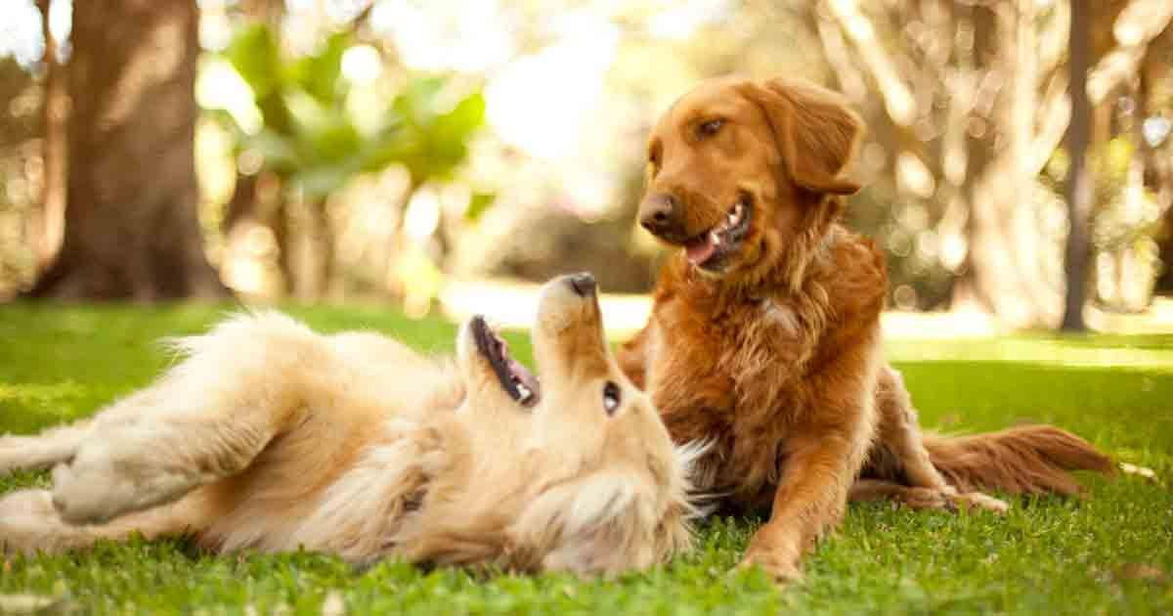
Dog Dating App
Ian Woods
Joshitha Mandali
David Acharya

Slide 2
DESCRIPTION
Doggy-Date: A dating app for dogs.
More specifically, dog owners can search other dogs in their area and establish playdates.
Follows standard dating app model (Bumble, Tinder), but instead of connecting humans, it connects dogs.
Users can
Search for other dogs
“Like” other dogs for potential playdates
If two dogs “like” each other, a match is made and users can chat to establish playdates.
Scope limitation: will focus only on the dogs, not the owners.

Slide 3
TECHNOLOGIES
JavaScript
MySQL
React
CSS
JSX

Slide 4
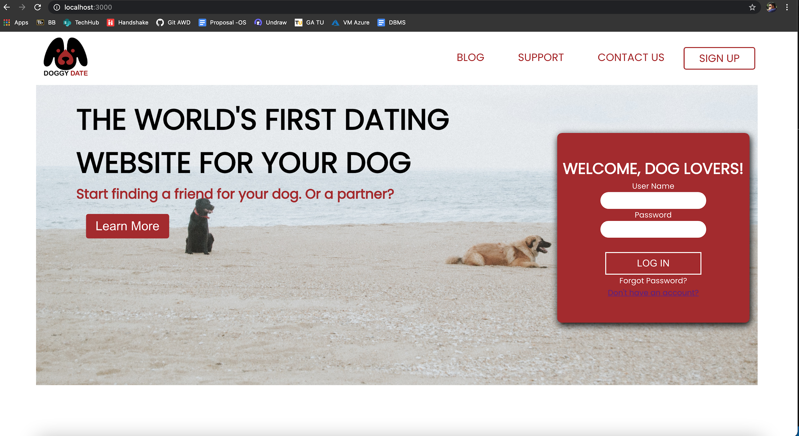
DEMO

Slide 5
NEXT STEPS?
Work on the remaining functionality
User profile - edit details and add photos
Meet other dogs
Display profiles of thers dogs
Filter other dogs by user preferences
Create match when two dogs like each other
Incorporate chat functionality for dogs that match
Frontend(React) + Backend

Slide 6
Questions? / Suggestions

